Slide 1

Watch Video
Call : +91 9629754500
Email: contact@codeshoppy.com

Slide 2
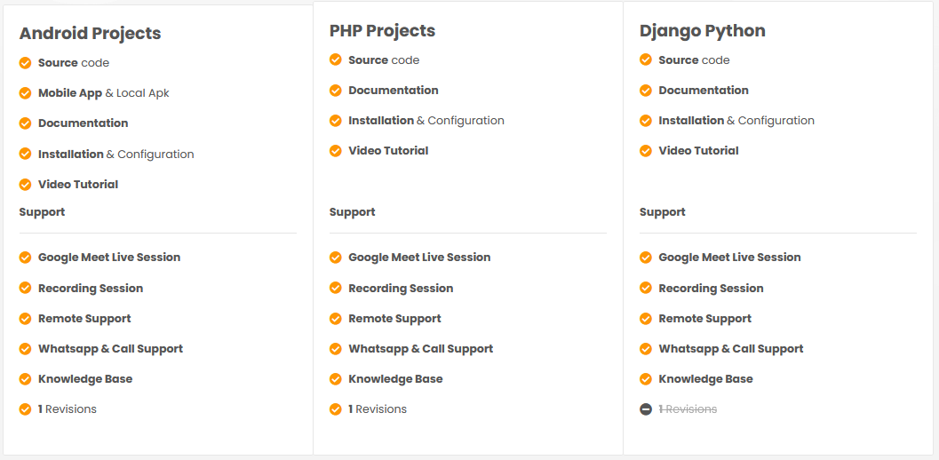

Slide 3
LOCATION BASED GARBAGE MANAGEMENT SYSTEM WITH FOR SMART CITY

Slide 4
AIM OF THE PROJECT
Smart cities integrate multiple mobile or web solutions to build a comfortable human habitation. One of these solutions is to provide an environmentally friendly, efficient and effective garbage management system.
The current garbage collection system includes routine garbage trucks doing rounds daily or weekly, which not only doesn't cover every zone of the city but is a completely inefficient use of government resources.
The proposed system, where admin manage the garbage app for full online based mointoring and analyze the system. Her admin handle bins, driver, complaints from user and work report from driver.
This paper proposes a cost-effective mobile or web based system for the government to utilize available resources to efficiently manage the over whelming amounts of garbage collected each day, while also providing a better solution for the inconvenience of garbage disposal for the citizens.
This is done by a driver, app will provide predictive and guide routes generated through for garbage trucks. Then driver update the status of work done will be data collected.
An android or web app is developed for the work force and the citizens, which primarily provides the user create complatints available smart bin.

Slide 5
OBJECTIVE OF THIS PROJECT
Garbage management system is a idea where we can control lots of problems which disturbs the society in pollution and diseases. The garbage management has to be done instantly else it leads to irregular management which will have adverse effect on nature.
The Smart garbage management is compatible mainly with concept of smart cities. The main objectives of our proposed system are as follows:
Monitoring the garbage management.
Providing a smart technology for garbage system.
Avoiding human intervention.
Reducing human time and effort
Resulting in healthy and waste ridden environment.
This project falls under the category of embedded systems and android applications.

Slide 6

SOFTWARE AND HARDWARE REQUIREMENTS
HARDWARE REQUIREMENTS:
Processor : Intel 3
Motherboard : Intel mother board – VTx Enabled
Ram : 4 gb
Hard disk drive : 500 gb
SOFTWARE REQUIREMENTS:
Front end : html5, css3, bootstrap
Back end : php, mysql
Control end : angular java script
Android TOOLS:
Android Emulator
xampp-win32-5.5.19-0-VC11
Android Studio
PHP Tools:
xampp-win32-5.5.19-0-VC11

Slide 7
EXISTING SYSTEM
Employees heading for their workstations every morning. For all those people, there are just not enough garbage bins available. On the streets of urban cities, hundreds of people are Passing the same location around one minute.
The obvious solution to this is for the cleaning staff to stay near garbage bins every day till they fill up to clean them. This is not a real solution.
There are some notable negative effects when considering the garbage bins always being full. One of the main effects is the surrounding area starting to smell and be very unpleasant. When the garbage bins are full people put their trash on sides of the garbage bins.

Slide 8
DISADVANTAGES OF EXISTING SYSTEM
It isn't compelling and which has a few hindrances which as pursues Less powerful and tedious.
Cost is extremely high.
Environment winds up unhygienic.
Terrible stench of garbage may cause infection.
More traffic and clatter in view of truck used to clean the container.
Bad smell spreads and may cause illness to human beings.
More traffic and Noise

Slide 9
PROPOSED SYSTEM
The proposed system overview for this system. Solid waste management can be broadly categorized as segregation, collection, and transportation.
The server will collect the data and store them only a database. This data will be analyzed and displayed on two different dashboards that can be accessed by the workforce and clients.
Using data analytics, reports will be generated which can be monitored by the admins through the admin dashboard.
Based on the data collected, garbage trucks can be given routes generated through various algorithms and Google maps API to efficiently route through all necessary garbage bins and finally reach the dumping site

Slide 10
ADVANTAGES OF PROPOSED SYSTEM
Real time information on the fill level of the dustbin.
Deployment of dustbin based on the actual needs.
Cost Reduction and resource optimization.
Improves Environment quality
Fewer smells
Cleaner cities
Intelligent management of the services in the city.
Effective usage of dustbins.

Slide 11
MODULE LIST
ADMIN
Login
Create garbage bin
Update/ delete garbage bin
Assign best route for drivers
Manage driver
View garbage report
View complaints from public

Slide 12
MODULE LIST
USER
Register
Login
Register complaint
My complaint and status
DRIVER
Login
Check daily work updates
Choose best route
Update garbage load

Slide 13
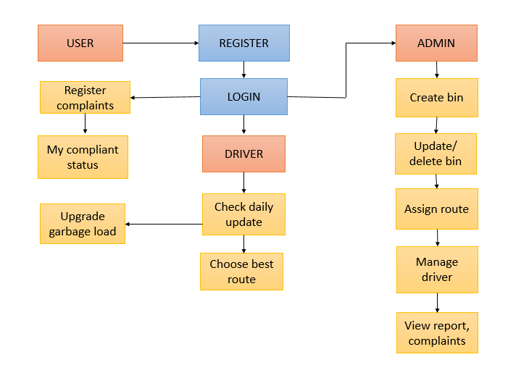
DIAGRAMS
ARCHITECTURE DIAGRAMS

Slide 14
ADMIN

Slide 15
USECASE DIAGRAMS
DRIVER
USER

Slide 16
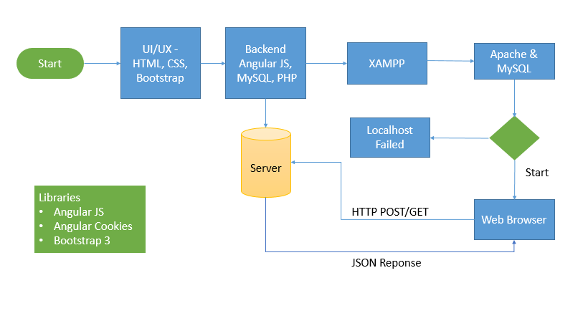
WORKFLOW DIAGRAM FOR WEB APPLICATION

Slide 17
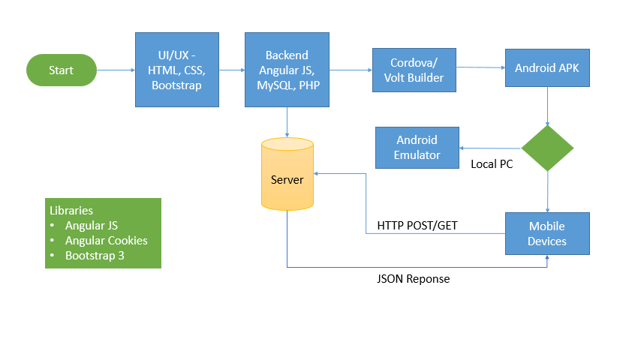
WORKFLOW DIAGRAM FOR ANDROID APPLICATION

Slide 18
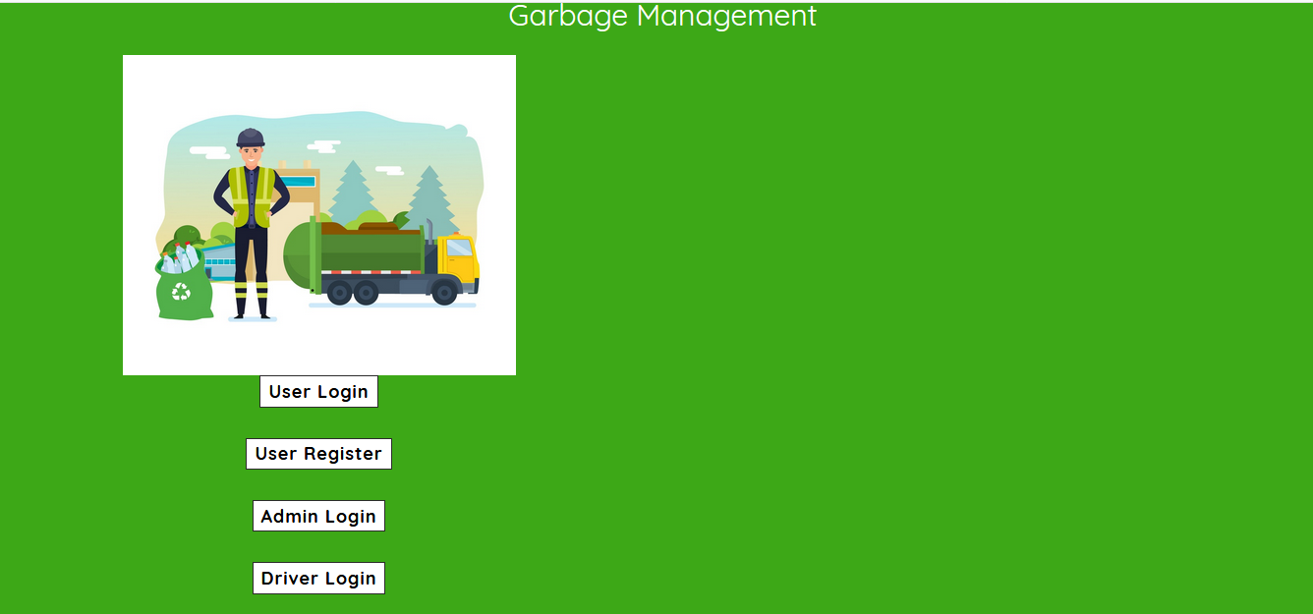
SCREENSHOTS

Slide 19
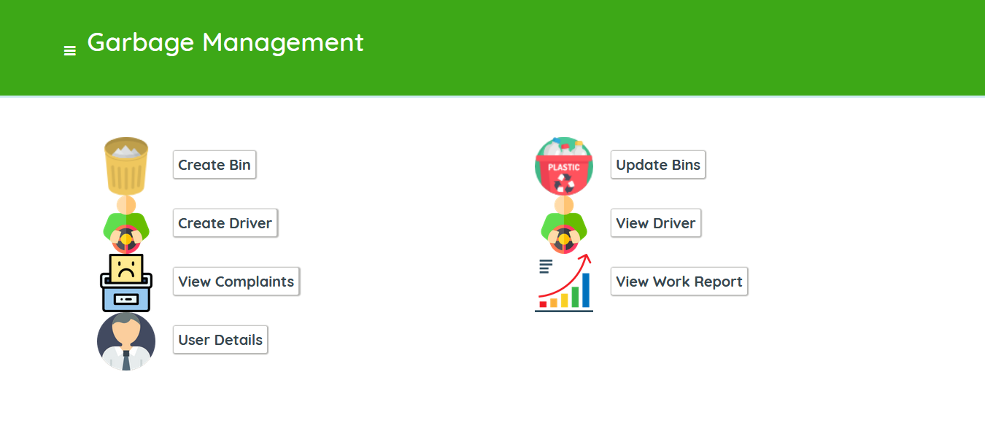

Slide 20
CONCLUSION
We have developed the cost-effective waste management system. Smart garbage management systems like these will go a long way in making our daily lives much healthier and toxic free.
Also, it can contribute to reducing fuel consumption of the garbage trucks by going for collection to particular areas only when the considerable amount of the cans is present in that particular geographic location that needs to be collected.
Since its requirement for funds is less, this system can become readily available in all countries that aren't looking forward to investing much in their garbage department.

Slide 21
FUTURE ENHANCEMENT
In future, This article incorporates IOT solutions to implement a system that provides the municipal council with a system that better equips them to handle the garbage problem in a smart city.
Every party is interacting with this system, that is the citizens, the workforce, and the admins.
Future work can include many areas. One area that can be improved on, but limited at this time due to trying to making this project low cost, is identifying types of garbage from the bin itself, thus removing human segregation.
If this is implemented, in a single location instead of four bins for the four different types of garbage, one large bin can be placed which segments the garbage by itself.
Another area which can be improved is instead of each bin connecting to an access point to communicate with the server, bins can communicate with each other and connect to an access point through the main hub.
This method may reduce network costs and make the network process more efficient.

Slide 22
REFERNECES
"Colombo Vehicle Statistics (2015)." Indi.ca. [Online]. Available: http://indi.ca/2015/10/colombo-vehicle-statistics-2015/. [Accessed: 09- Jan-2017]
"Population and Housing." Population and Housing. [Online]. Available: http://www.statistics.gov.lk/page.asp?page=Population%20and%20Hous ing/. [Accessed: 09-Jan-2017]
Council, Colombo Municipal. "Colombo Municipal Council." Garbage Collection. [Online]. Available: http://colombo.mc.gov.lk/garbagecollection.php/. [Accessed: 04-Jan-2017]
S. Lokuliyana, J. A. D. C. A. Jayakody, L. Rupasinghe, and S. Kandawala, "IGOE IoT framework for waste collection optimization," 2017 6th National Conference on Technology and Management (NCTM), Malabe, 2017, pp. 12-16.
R. Fujdiak, P. Masek, P. Mlynek, J. Misurec and E. Olshannikova, "Using genetic algorithm for advanced municipal waste collection in Smart City," 2016 10th International Symposium on Communication Systems, Networks and Digital Signal Processing (CSNDSP), Prague, 2016, pp. 1- 6.
T. Anagnostopoulos, A. Zaslavsky, A. Medvedev, S. Khoruzhnikov, “Top-k Query based Dynamic Scheduling for IoT-enabled Smart City Waste Collection,” In Proc. of 41 the 16th IEEE International Conference on Mobile Data Management (MDM 2015), Pittsburgh, US.

